Slide 1

Middle Earth Adventures
Center yourself in Middle Earth

Slide 2
Mission Statement
Soft Adventure geared towards personal growth and learning through nature. We focus on sustainable environmental awareness by integrating sea kayaking and eco-spa retreats. Baby boomers and future generations will continue to enjoy these and other ventures in kids camps, alternative education and dog sledding.

Slide 3
Corporate Strategy Statement
Middle Earth Adventures provides a safe and positive working environment for staff and clients. It offers job security and potential growth within the company. We are a for-profit company that encompasses all five aspects of Ecotourism (sustainability, educative, conservation oriented, nature-based, and enhances and contributes to local communities) as well as promoting happy, healthy living.

Slide 4
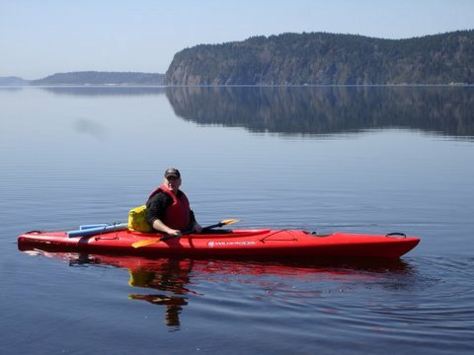
The Product
Product mix includes:
Water Services
Education Services
Spa Services
Winter Services
And some of our product line…
Sea kayaking tours and instruction, free educational workshops, spa packages, dog sledding, and much more!

Slide 5
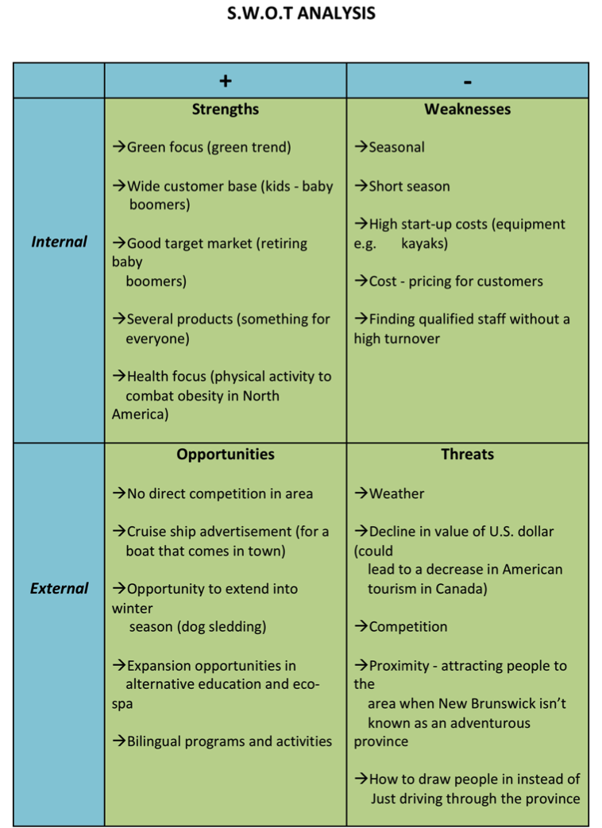
S.W.O.T.
Used to show the strengths, weaknesses, opportunities and threats for Middle Earth Adventures

Slide 6
Environmental Analysis
The 6 Environmental factors
Competitive
Economic
Political
Legal and Regulatory
Technological
Socio-cultural

Slide 7
Primary Customer Profile
Baby Boomers
Over 35+ Set
Middle to high income
Families
Eco-tourists

Slide 8
The Competition
Rockwood Park
Only family oriented, not just sea kayaking
Go Fundy Adventures
Strictly for cruise ship tourists
Eastern Outdoors
High adventure, seasonal, tourist based
BC & Nova Scotia
Famously known for adventure sports. Not this kind

Slide 9
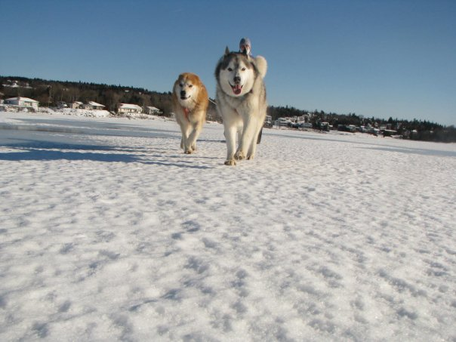
Product Strategy
Offers year round eco-adventure and spa services
Focuses on sustainability
Values customers and employees
Emphasis on positive learning environment

Slide 10
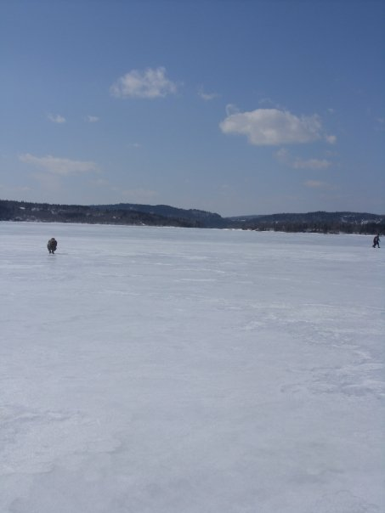
Pricing Strategy
For-Profit Company
Enables us to focus on sustainability with:
Employees
Customers
The environment
Business practices

Slide 11
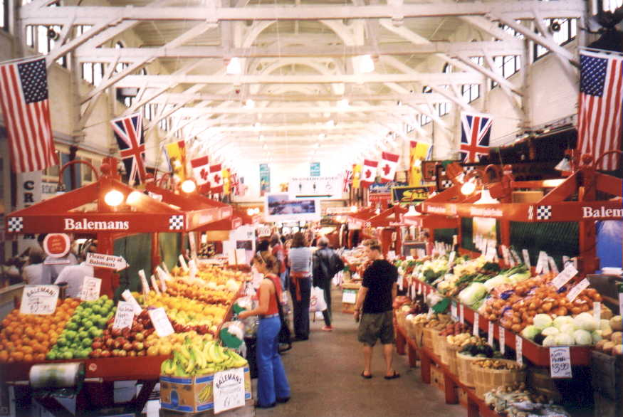
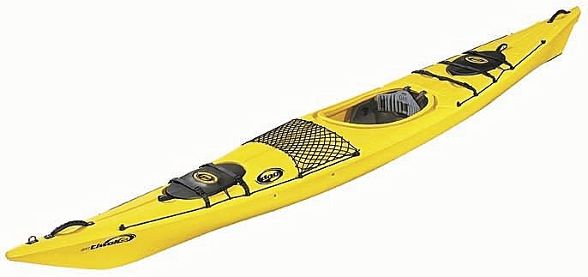
Channel Strategy
Quality second hand kayaks purchased from Eastern Outdoors
Food and spa needs purchased locally at Saint John City Market

Slide 12
Promotion Strategy
Sales! 15% off if you book early
Advertisement; flyers, brochures, internet ads, webpage, etc
Community involvement: Buying locally, community space for workshops and activities
Personal selling

Slide 13
Budget

Slide 14
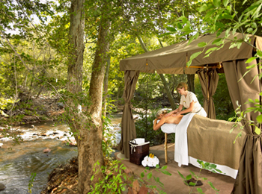
Thank you!
AJ Doak, Jessica Kinsley, Zara MacKay-Boyce, Michelle McCaffrey

